Slide 1
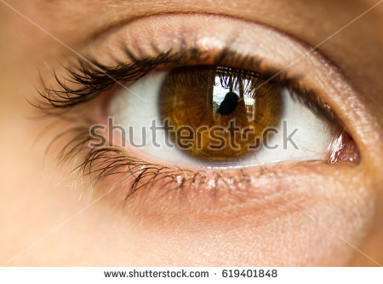
Identifeye
Zak Fahey, Mitchell Haas, Brendan Fisher

Slide 2
Purpose and Goal
Changing your identity online can be as simple as flipping a switch.
By using VPNs users can circumvent bans, or post as anyone online.
People can also get into accounts who aren’t supposed to access them.
We plan to use data analysis to identify users who are changing their online identity.
Essentially, we want to map online identities to real people, even if the data is obscured.
We will achieve this by starting with a cleaned up dataset and discovering which attributes and classifiers work the best.

Slide 3
Who are we?
Zak Fahey faheyzt@mail.uc.edu
Mitchell Haas hassm3@mail.uc.edu
Brendan Fisher fisherb8@mail.uc.edu
Advisor: Raj Bhatnagar bhatnark@ucmail.uc.edu

Slide 4
Project Description
The object of this project is to build profiles on people and detect rule breaking behavior such as avoiding bans or sharing accounts.
Once we have identified these attributes we will test multiple analysis algorithms to find the optimal one for our analysis core.
After we have the analysis core setup we can apply it to many cases such as:
mass duplicate account
ban evasion
account sharing

Slide 5
Computing and Software Design
We will start with a cleaned up dataset that can be found here: data set
It is a set of Amazon Reviews
Each review is broken down into 1000 attributes that describe the authors linguistic style and use of digits, punctuations, words and sentence length, usage frequency of words, etc..
Their is 30 reviews per author so this data set can be used for authorship identification
We plan to add a few reviews of our to the dataset to have it classify when it is none of the known authors
We will use this data set to test which classifiers work the best such as:
Neural Networks
Non-Linear SVM
This process will help to identify which attributes work the best from the data set and which classifiers work the best for authorship identification.
A stretch goal from here would be to then add natural language processing to convert plain text into our own data set and apply the best attributes and classifiers we discover.

Slide 6
User Stories
As a developer, I want an easy-to-use, extensible, and capable user analysis program so that I can easily deal with the problem of users who abuse my system.
As an admin, I want a simple interface to visualize user trends so I can see where problems are and take action accordingly.
As a product owner, I want a solution that deals with abusive users so that my product is as good, useful, and free of problems as possible.

Slide 7
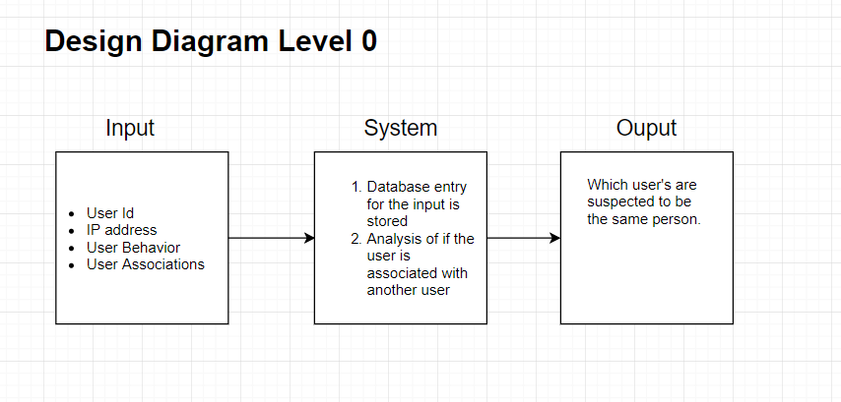

Slide 8
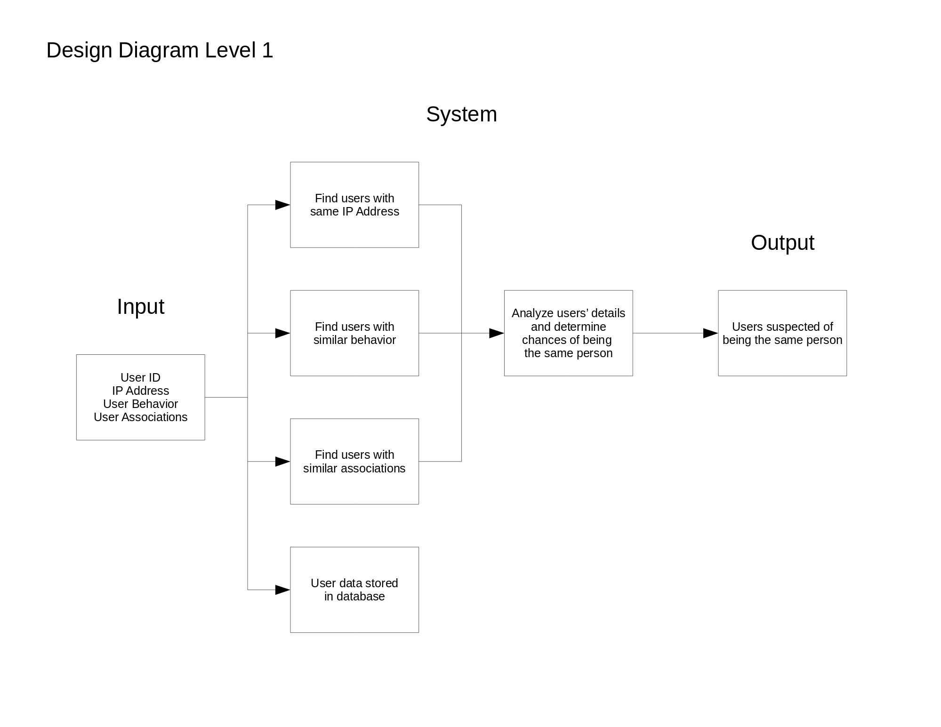

Slide 9
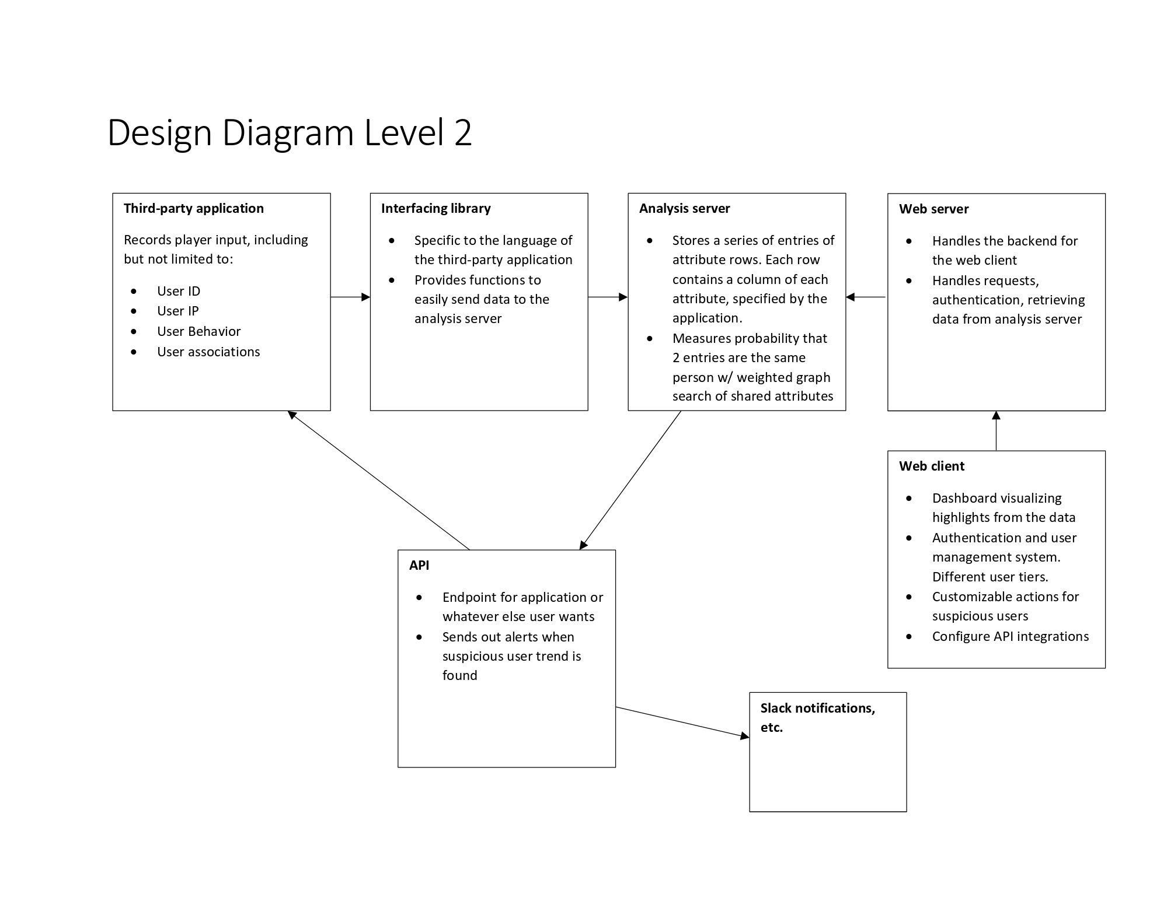
Design Diagrams

Slide 10
Review of Project Progress
So far, we have completed the planning stage for the project.
Planning the division of labor
Finding a Data Set
We have an understanding of how we’re going to implement the code.
Now all that’s left to do is implement the code.

Slide 11
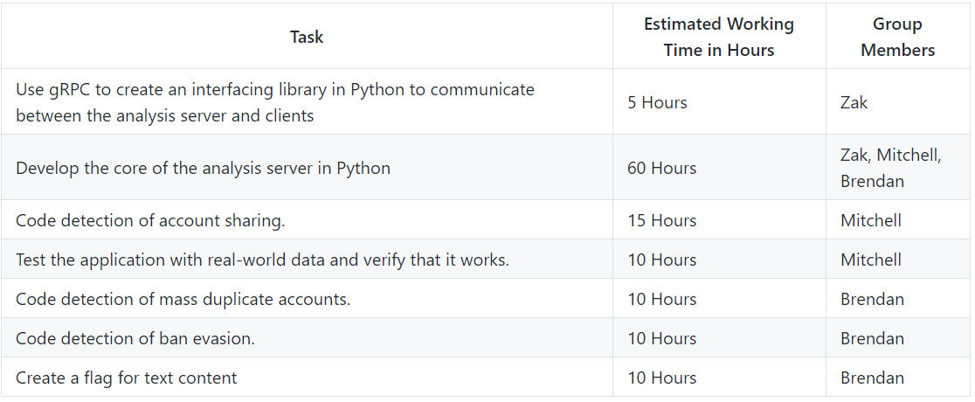
Division of Work
Zak is leading the design of the core architecture of the systems. Pluggable library system, etc.
Brendan and Mitchell are implementing specific subsystems for detecting specific behavior.

